Slide 1

The RED System
Creative Learning Teams: Observation action-learning
Tony Davis
@c4cqi

Slide 2
Creative Learning Teams
By the end of this introductory session I hope that you will:
be able to precisely identify the impact on learning of specific teaching strategies
identify your own concerns about the observation process
feel confident to engage positively with the Creative Learning Team
look forward to being observed and observing others
be curious about how others achieve learning impact.

Slide 3
Creative Learning Teams
Aims for the whole day:
feel confident in what you are doing well
be inspired by the work of others
have identified some new impacts you want to steal (and possibly also the strategies used to achieve them)
have identified some ideas for improving the learning impact on your own learners
be keen to research new and innovative teaching strategies with which to experiment.

Slide 4
Creative Learning Teams
This day is not about:
telling staff what they’re doing wrong and what they should do to improve.

Slide 5
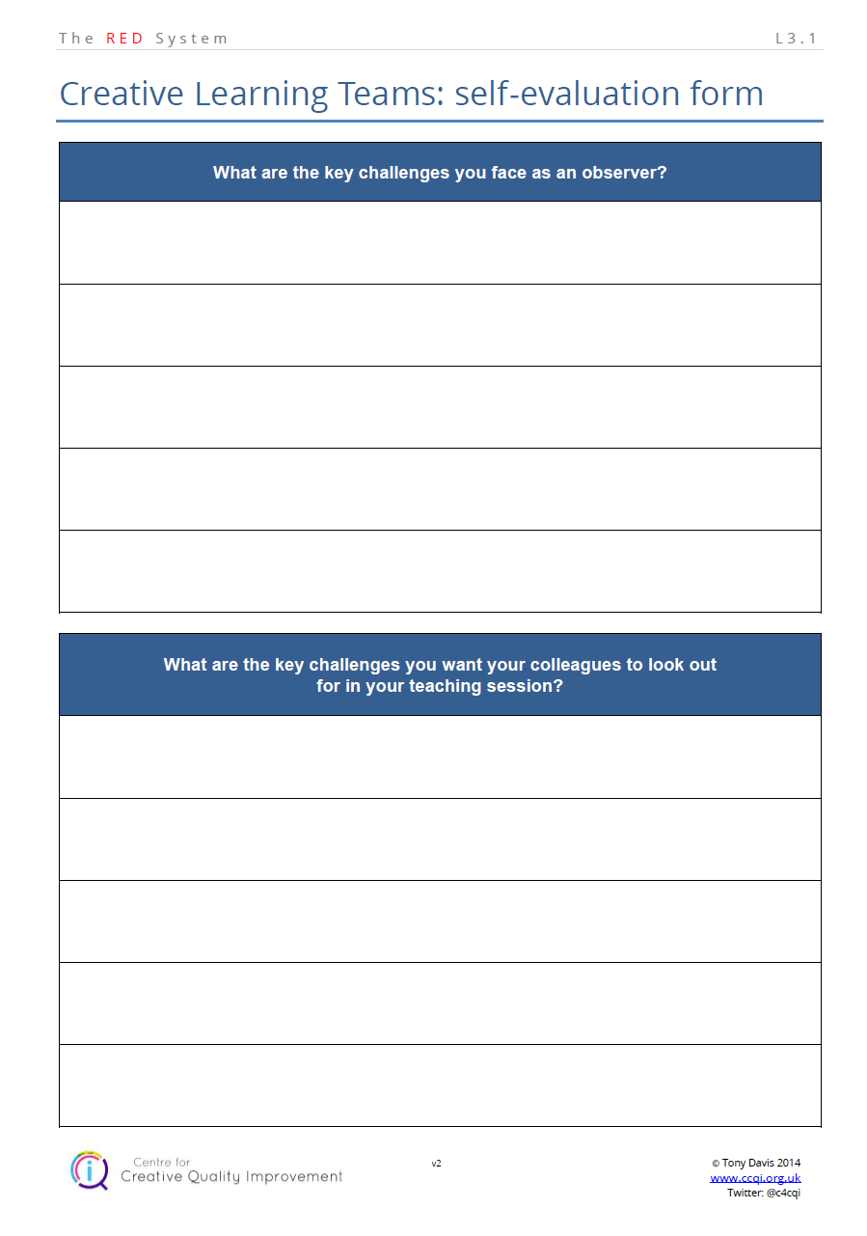
Creative Learning Teams

Slide 6
Creative Learning Teams
08:15 | Introductions, methodology, ground rules
09:00 | Observation of teacher A
10:00 | Post-observation debate (without teacher A)
10:15 | Evaluative conversation with teacher A
10:45 | Break
11:00 | Observation of teacher B
12:00 | Post-observation debate (without teacher B)
12:15 | Evaluative conversation with teacher B
12:45 | Lunch
13:30 | Observation of teacher C
14:30 | Post-observation debate (without teacher C)
14:45 | Evaluative conversation with teacher C.
15:00 | Break
15:15 | Observation of teacher D
16:15 | Post-observation debate (without teacher D)
16:30 | Evaluative conversation with teacher D
16:45 | Completion of ideas plans
17:00 | Evaluation of the day and implications for the future
17:30 | Finish

Slide 7

Creative Learning Teams

Slide 8
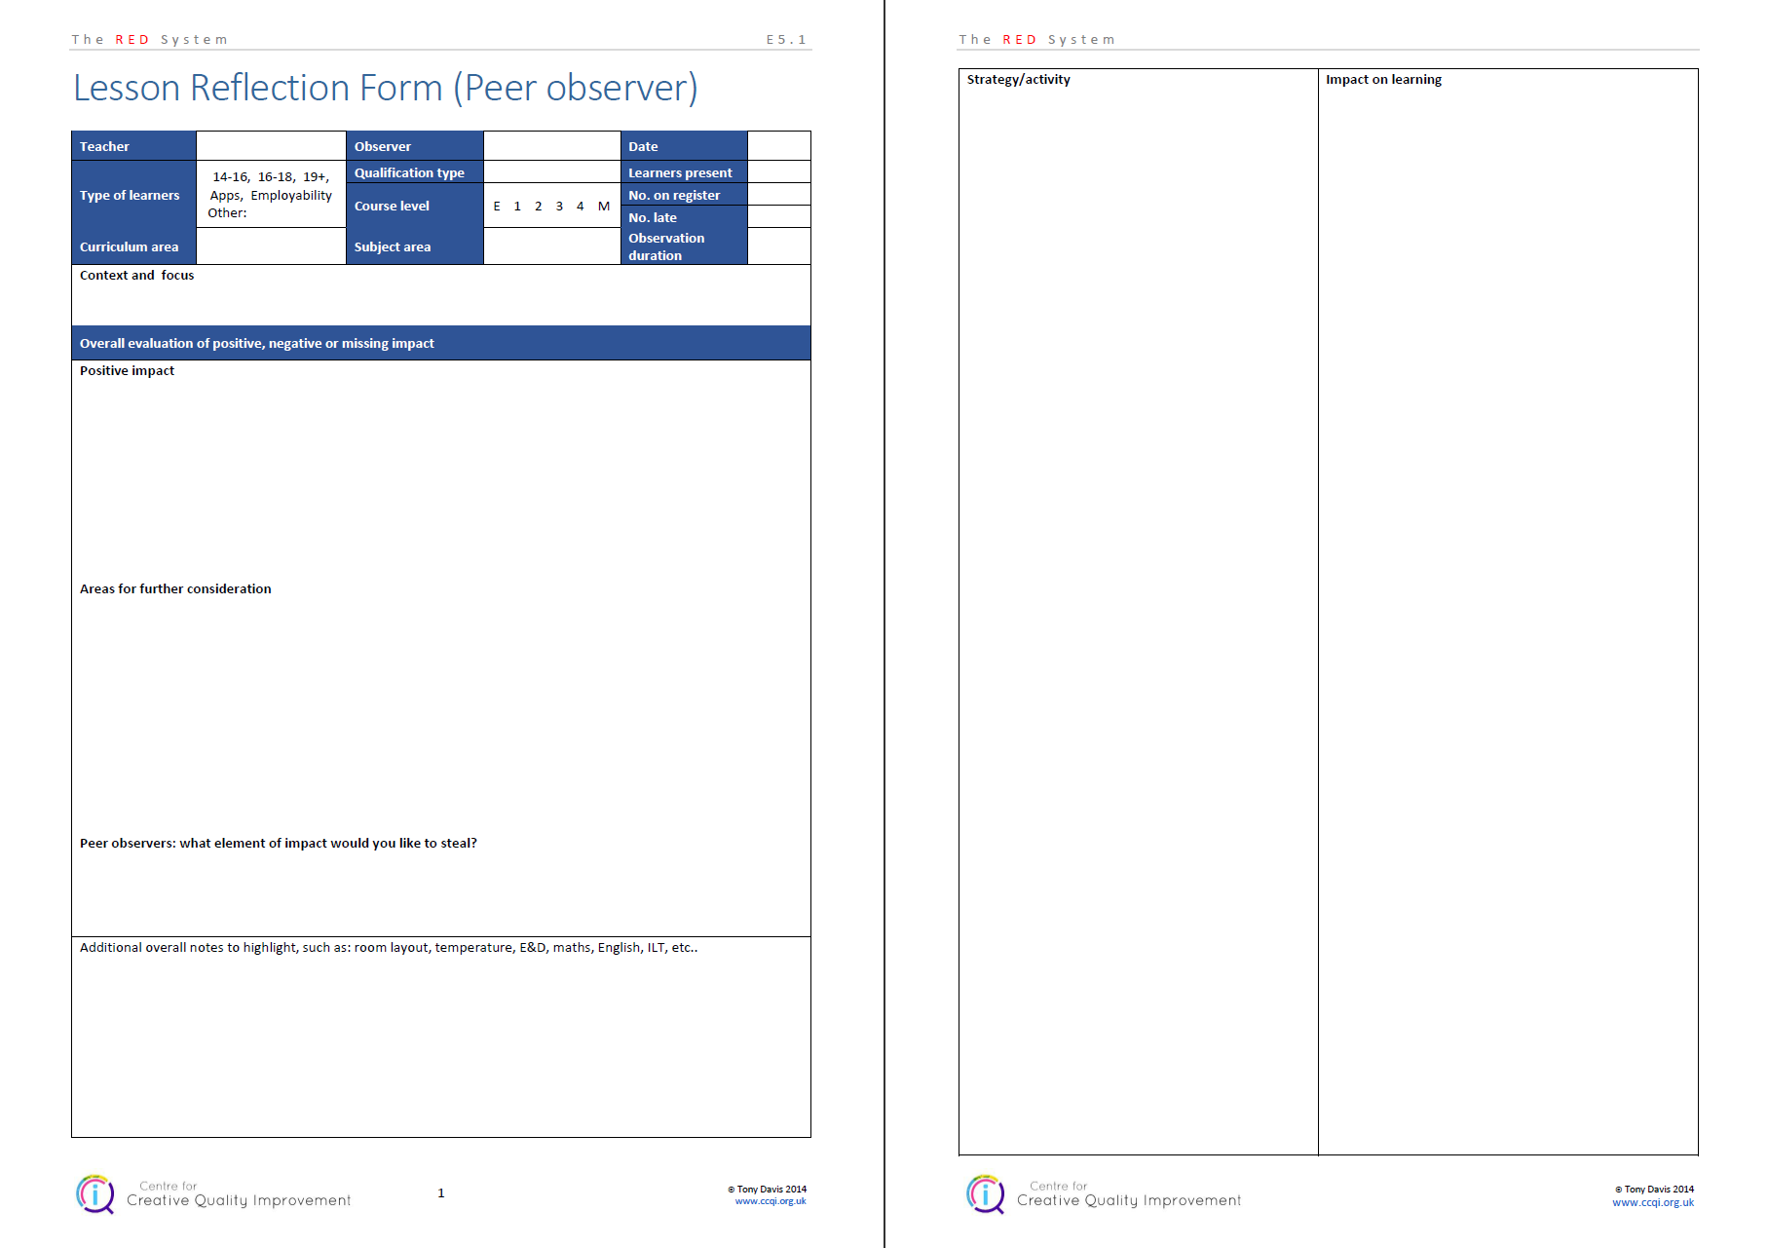
Creative Learning Teams

Slide 9
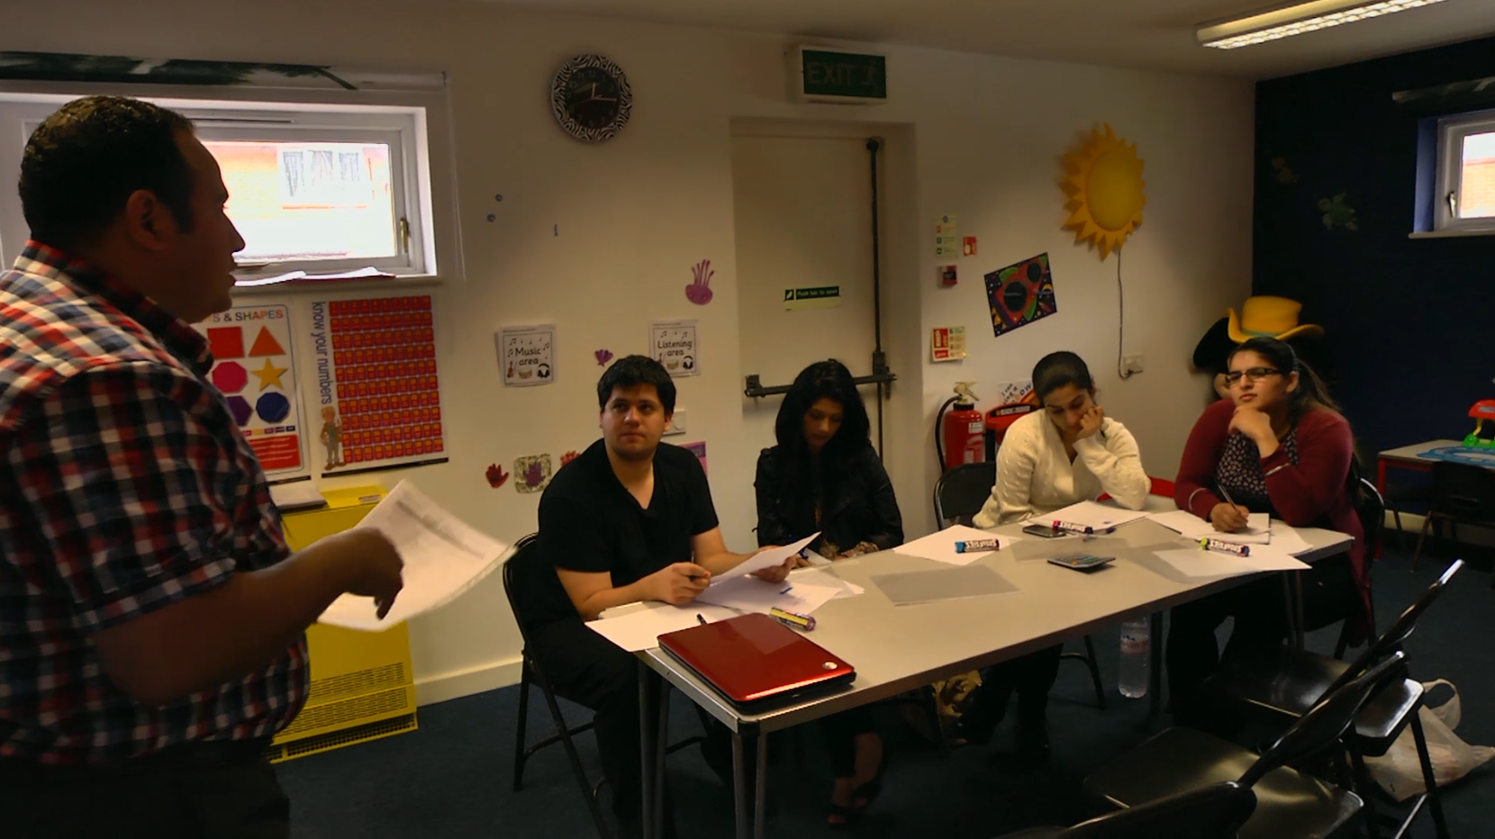
Creative Learning Teams
Functional Skills lesson

Slide 10
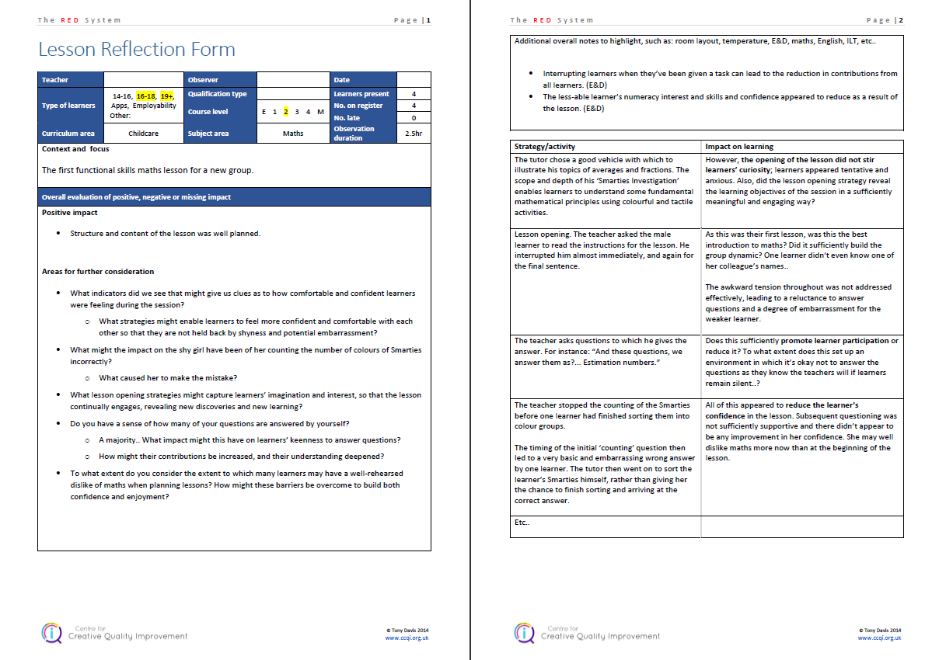
Creative Learning Teams

Slide 11
Creative Learning Teams
Today is the beginning of a period of experimentation, review and reflection.
If we get this right:
learners will do more, and
learn more, and
teachers will have to do less.

Slide 12
Creative Learning Teams
End of today
Following the last evaluation:
evaluate the whole day
ideas you’d like to steal
areas of impact you want to improve.

Slide 13
Creative Learning Teams
08:45
Begin observations

Slide 14
Creative Learning Teams
Afternoon session

Slide 15
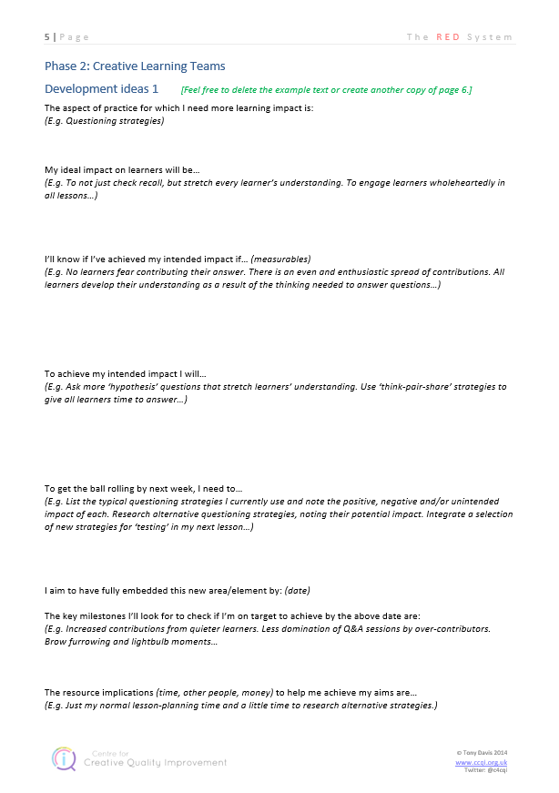
Creative Learning Teams

Slide 16
Creative Learning Teams

Slide 17
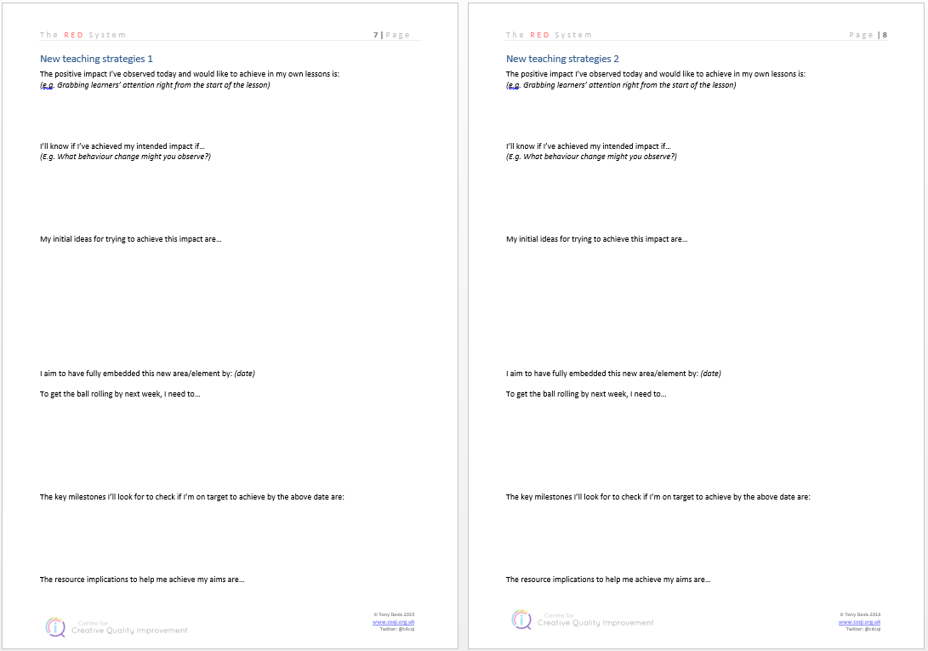
Creative Learning Teams

Slide 18
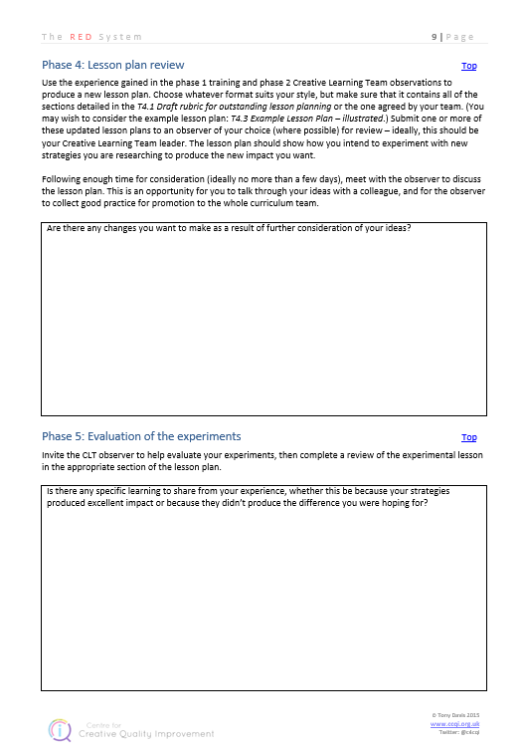
Creative Learning Teams

Slide 19

Creative Learning Teams

Slide 20
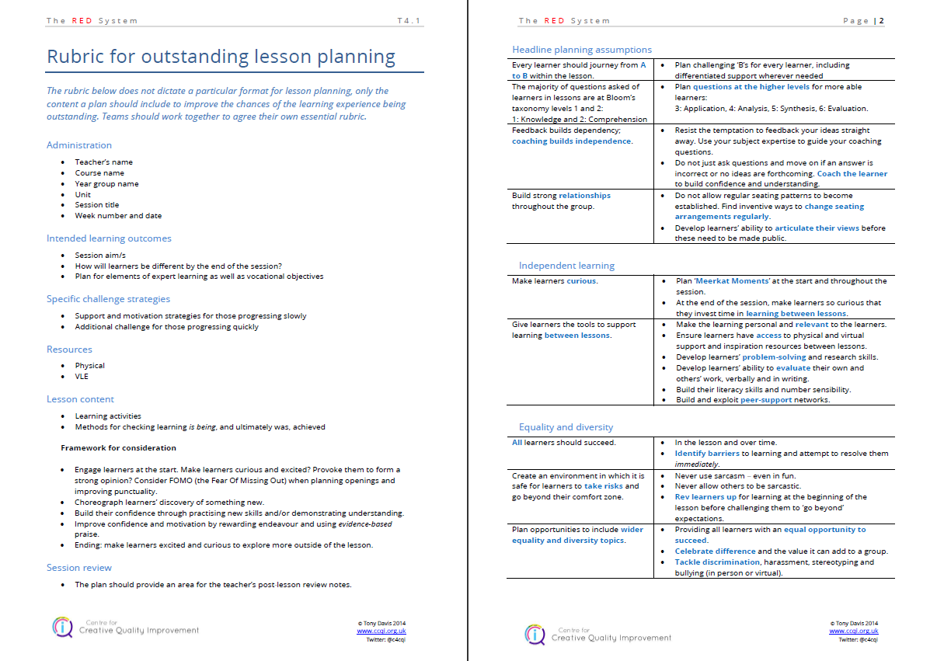
Creative Learning Teams

Slide 21
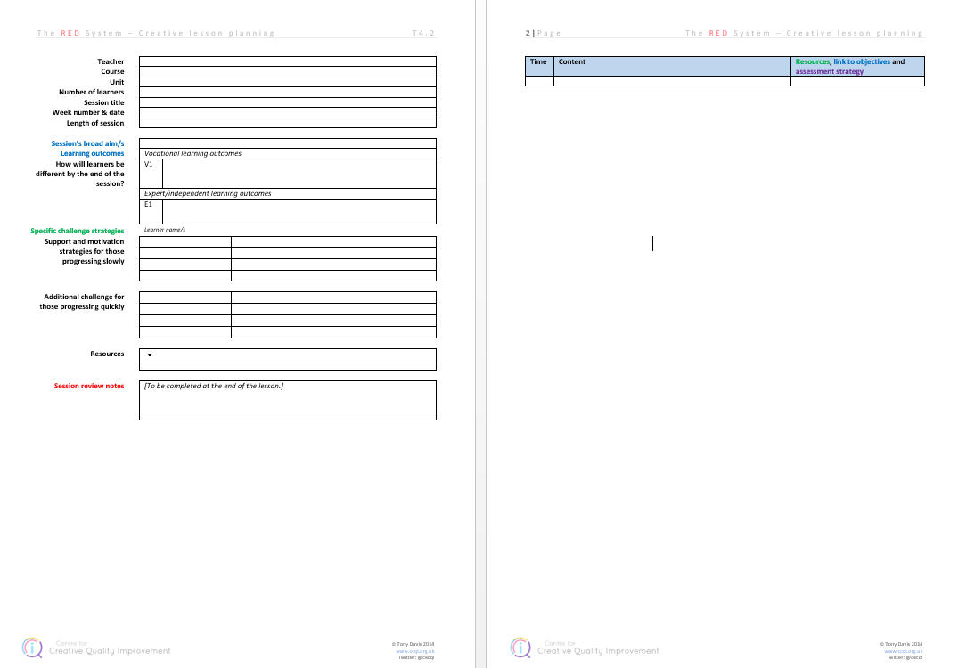
Creative Learning Teams

Slide 22
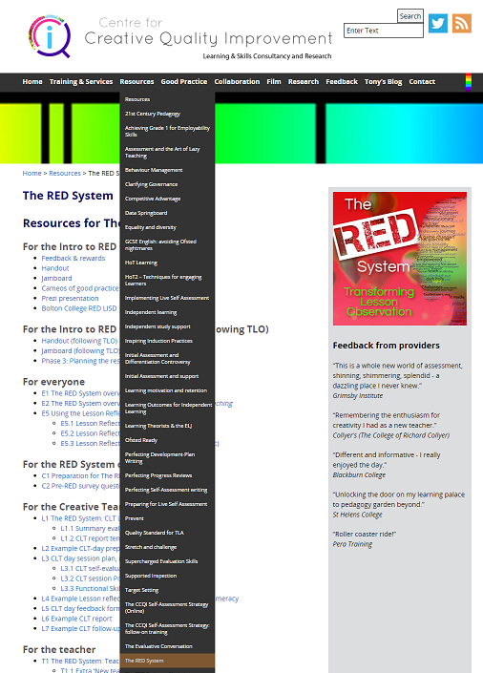
Creative Learning Teams
www.ccqi.org.uk/redresources
Password: red4686

Slide 23
Creative Learning Teams
www.ccqi.org.uk/redresources
Password: red4686

Slide 24
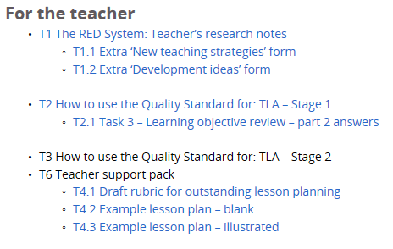
Creative Learning Teams

Slide 25
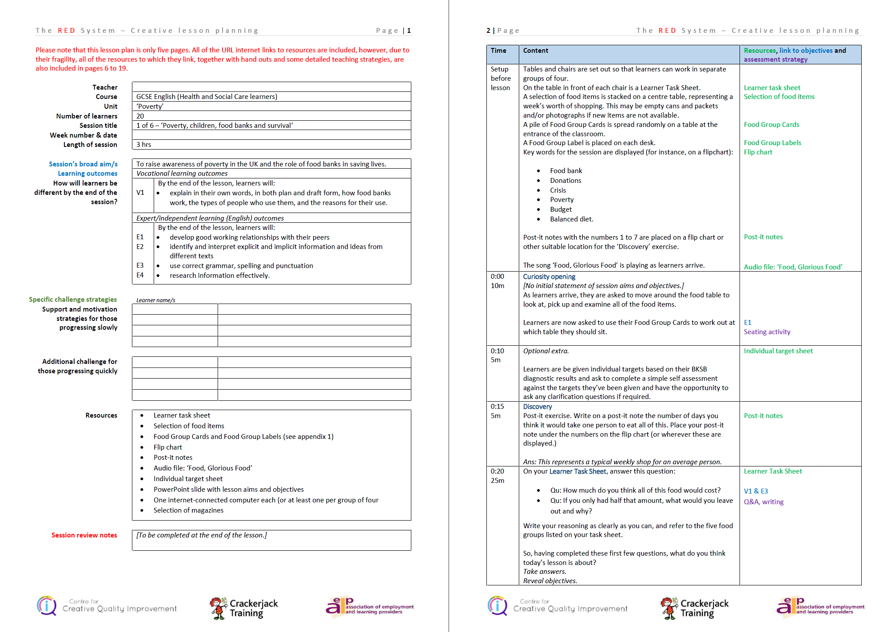
Creative Learning Teams

Slide 26
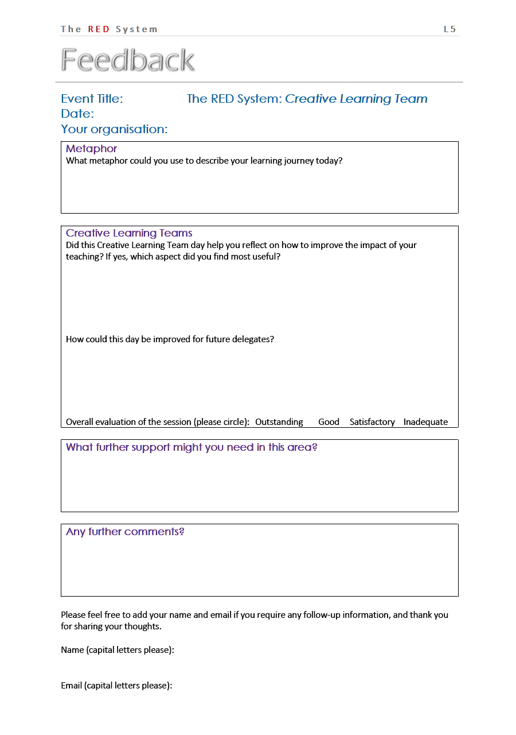
The RED System
Creative Learning Teams: Observation action-learning
Tony Davis
@c4cqi
www.ccqi.org.uk

