Slide 1

The Art of using Target Setting
Tony Davis
Twitter: @c4cqi

Slide 2

The Art of using Target Setting

Slide 3

The Art of using
Target Setting

Slide 4
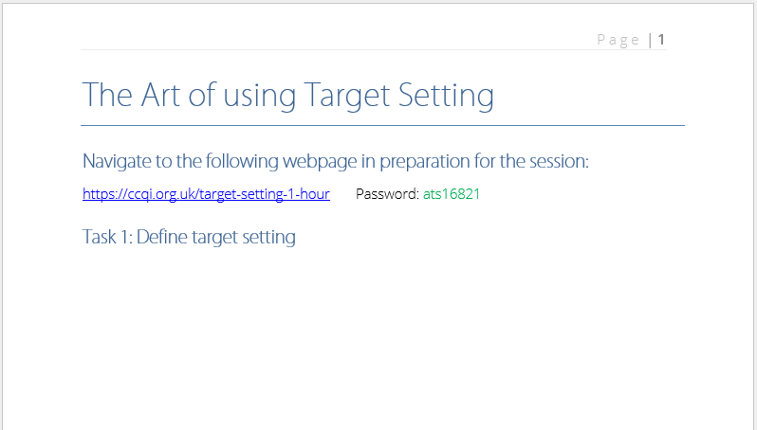
The Art of using Target Setting

Slide 5

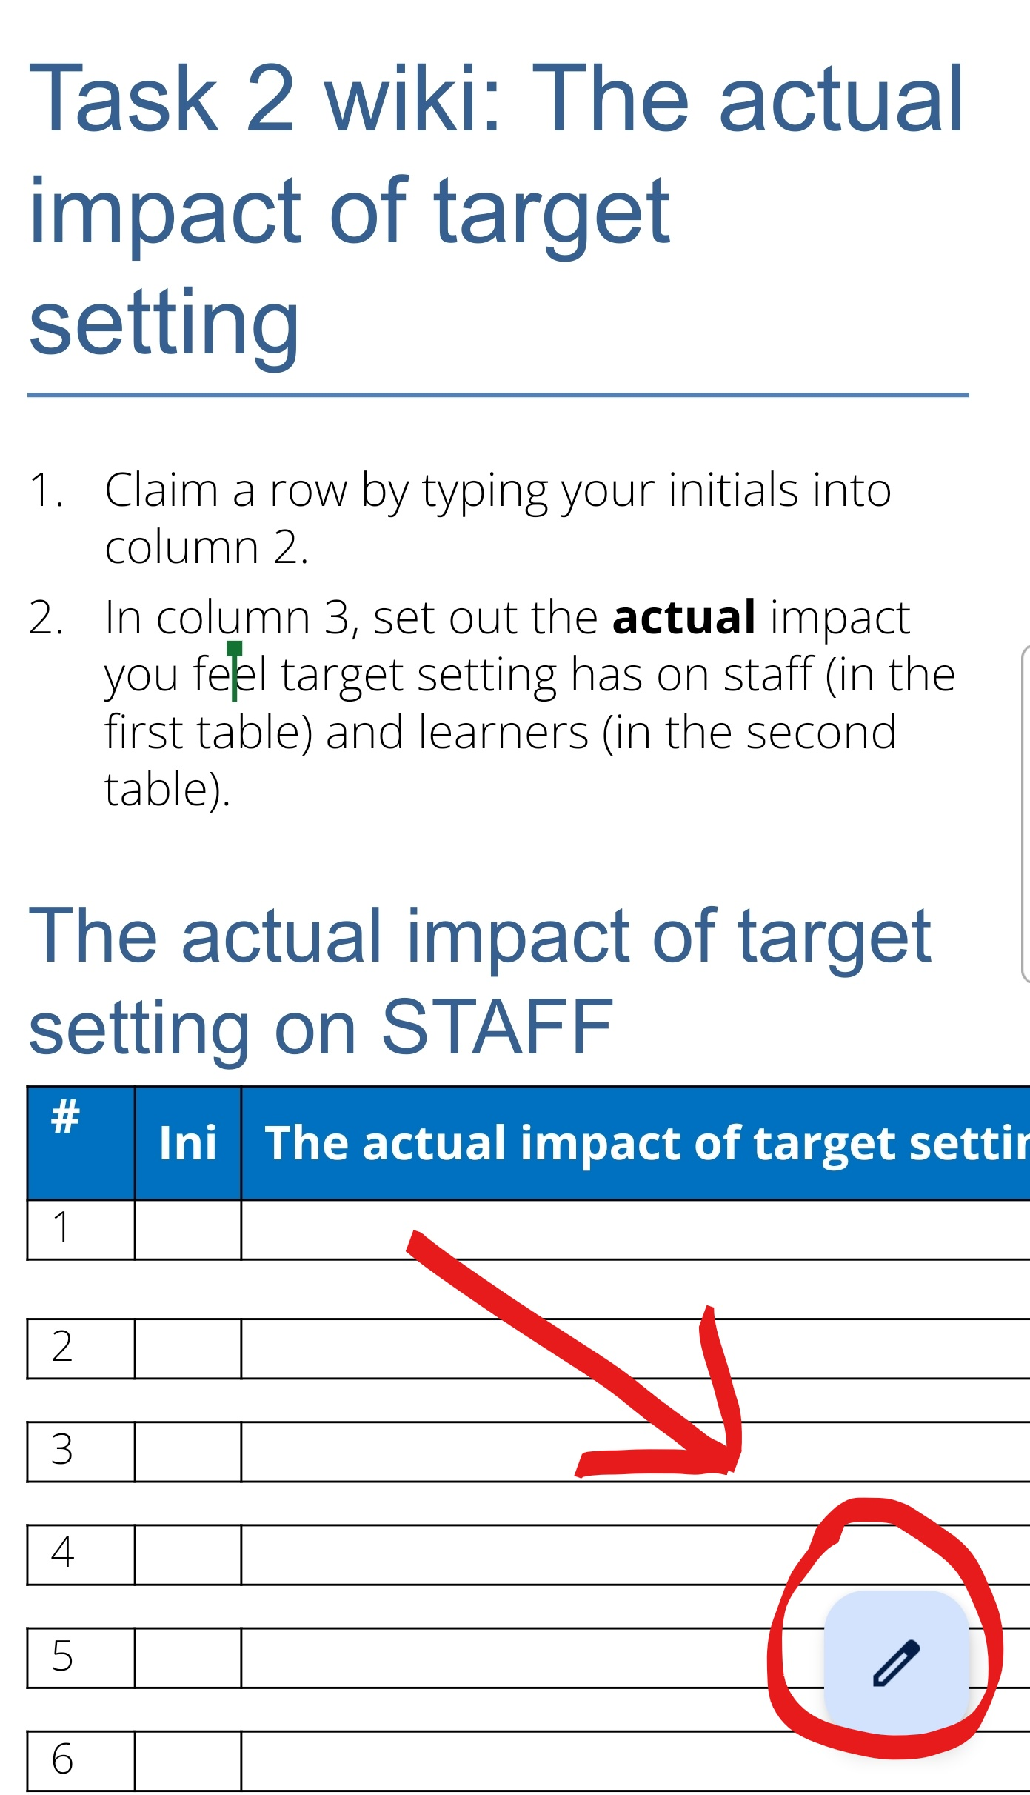
The Art of using Target Setting
Tap pencil
Click box to select
Click again to type

Slide 6
The Art of using Target Setting
The issues from Ofsted’s perspective
‘Targets in individual learning plans are too vague and fail to motivate or challenge learners.’
‘Teachers on vocational courses do not involve the learners well enough in setting their own targets, so that learners understand how to improve.’
‘Too many learners are unsure about what targets they have been set or how their teachers monitor their progress through the year.’
‘Teachers do not set meaningful targets for students.’

Slide 7
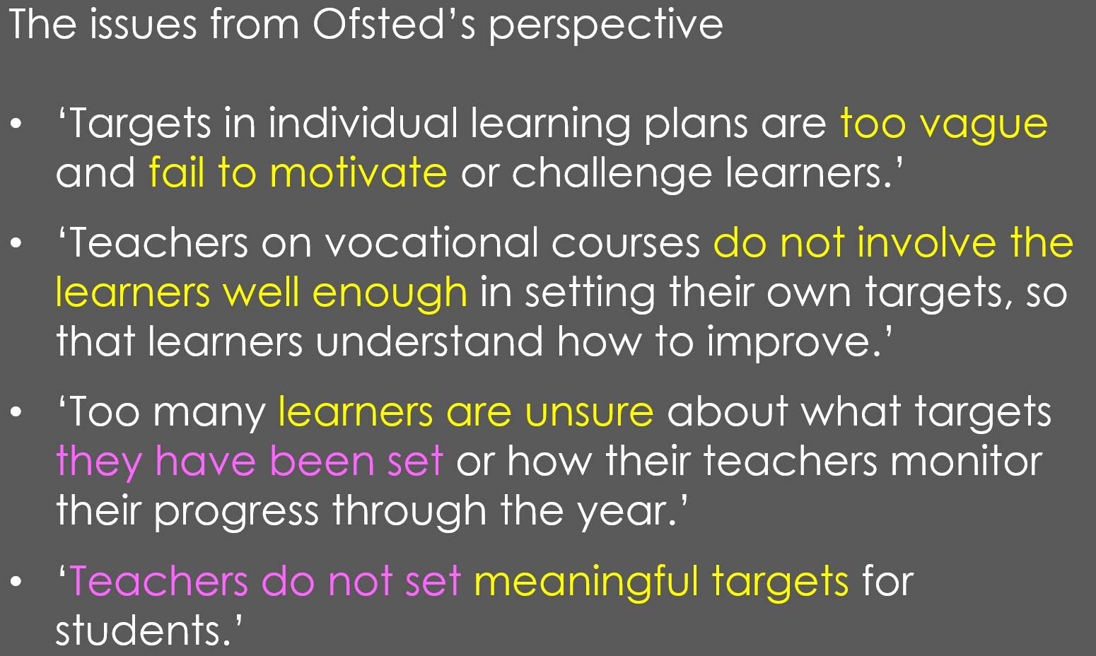
The Art of using Target Setting
‘Tutors should use their assessment of learners’ starting points to plan lessons that provide sufficient stretch and challenge for the most able learners.
Tutors should set ambitious personal targets for learners so that all learners make the progress they are capable of achieving.’

Slide 8
The Art of using Target Setting
Overall aspirations
Teachers value the process of initial assessment and use the information to plan differentiated support for unmissable learning
Target setting is learner-centred and aspirational, and drives learners’ wholehearted commitment to their learning.
All learners are appropriately stretched and supported in all lessons.

Slide 9
The Art of using Target Setting
Overall aspirations
"What you get by achieving your goals is not as important as what you become by achieving your goals.“
Michelangelo

Slide 10
The Art of using Target Setting
Overall aspirations
"What you get by achieving your goals is not as important as what you become by achieving your goals.”
Michelangelo
‘A vision of how you will be different’.

Slide 11
The Art of using Target Setting
Write some aspirational learning targets for your jazz-harmony course.

Slide 12
The Art of using Target Setting
The fundamental, Catch 22 problem of target setting:
that to write really good, specific targets you need to know what you’re talking about before you’ve learnt what you’re talking about..

Slide 13
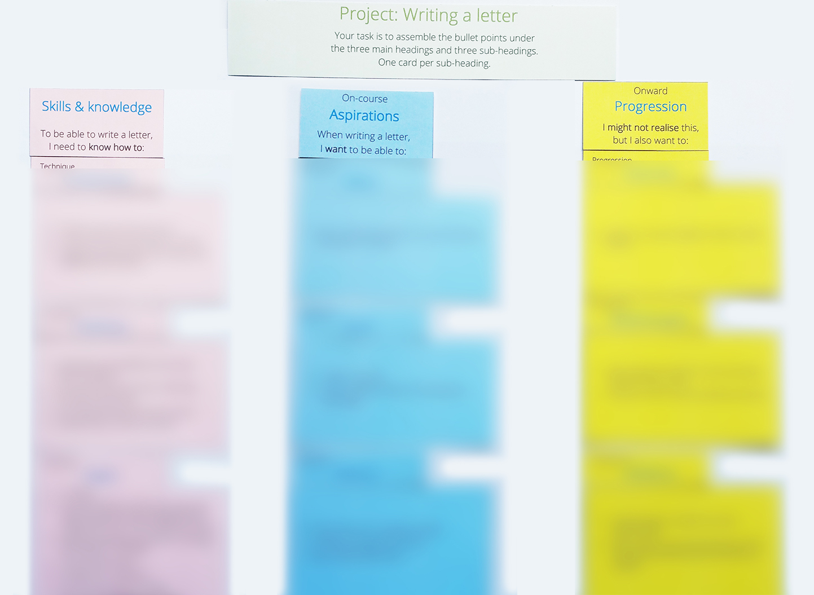
The Art of using Target Setting
In pairs, complete the card-sort activity for a short course on using Microsoft Word.

Slide 14
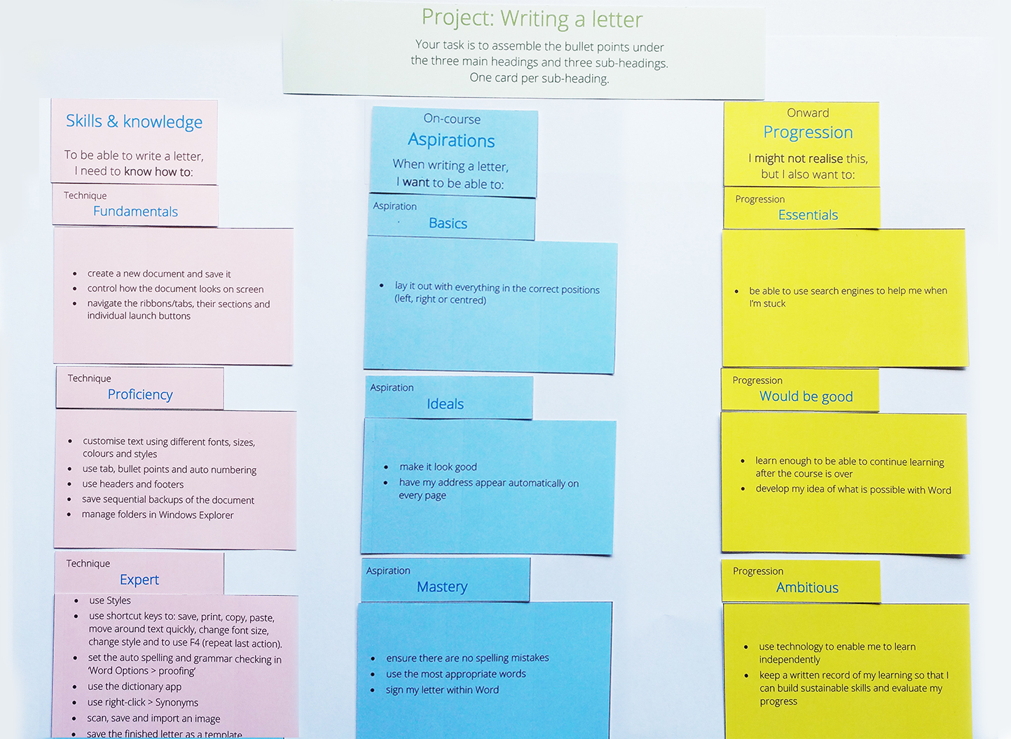
The Art of using Target Setting

Slide 15
The Art of using Target Setting
All three headings are important, but what is the hierarchy within this – which is most important?
Skills and knowledge
On-course aspiration
Onward progression

Slide 16
The Art of using Target Setting
All three headings are important, but what is the hierarchy within this – which is most important?
Skills and knowledge
On-course aspiration
Onward progression
Aspirations, as this is what creates the desire to learn.

Slide 17
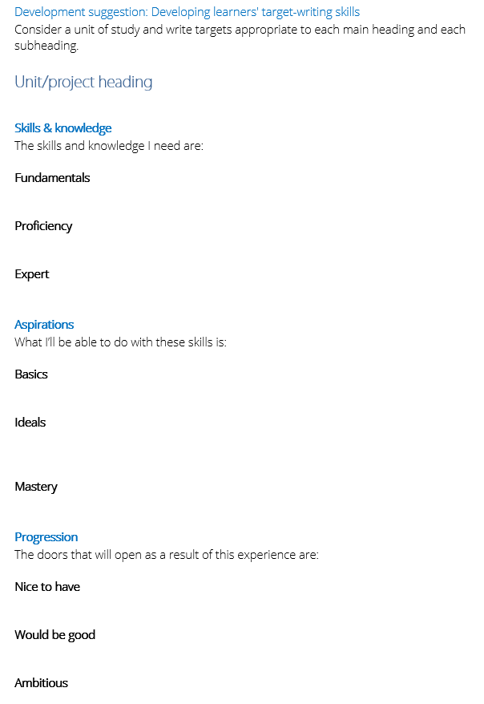
The Art of using Target Setting
Practise writing some outcomes under the suggested headings for an aspect of your own provision.
The skills and knowledge I need are…
With these skills, I’ll be able to…
The doors that will open as a result of this experience are…

Slide 18
The Art of using Target Setting
What, then, are the implications for our target setting work?

Slide 19
The Art of using Target Setting
What, then, are the implications for our target setting work?
Learners need to be taught how to write motivational targets.
Learners need to be taught how to project manage the achievement of those targets.
And teachers need to continually consider aspiration management as central to their role – helping learners understand how they will be different once they've achieved their goals.

Slide 20
The Art of using Target Setting

Slide 21
The Art of using Target Setting
Teach learners to project manage their learning.
Make it the cultural norm that they do this every week.

Slide 22
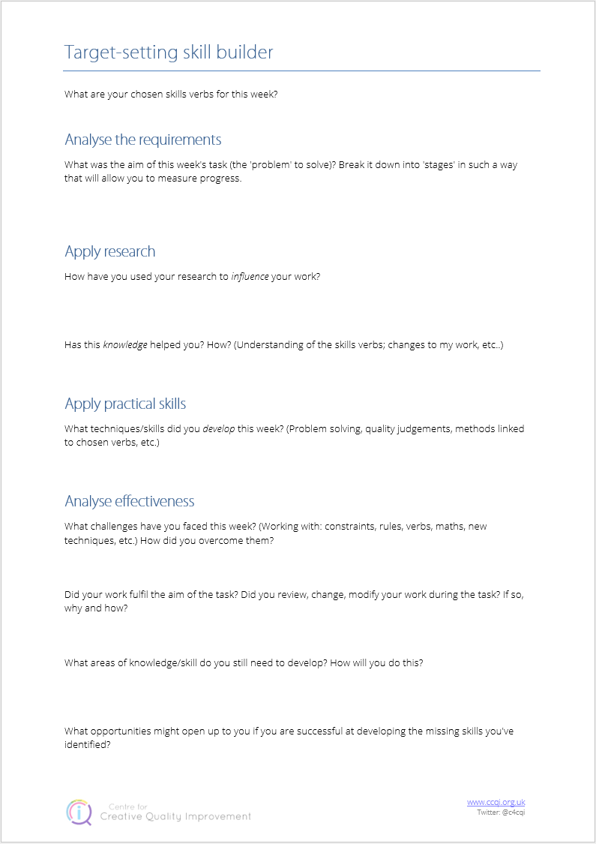
The Art of using Target Setting

Slide 23
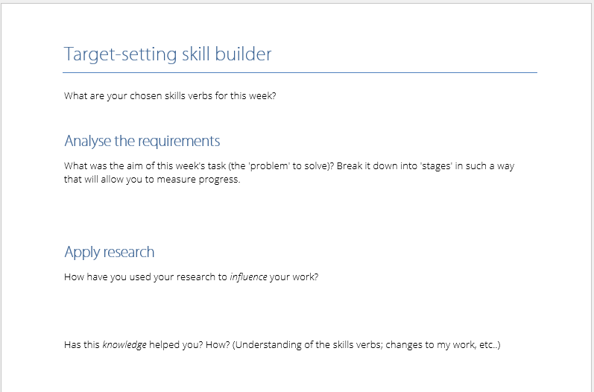
The Art of using Target Setting

Slide 24
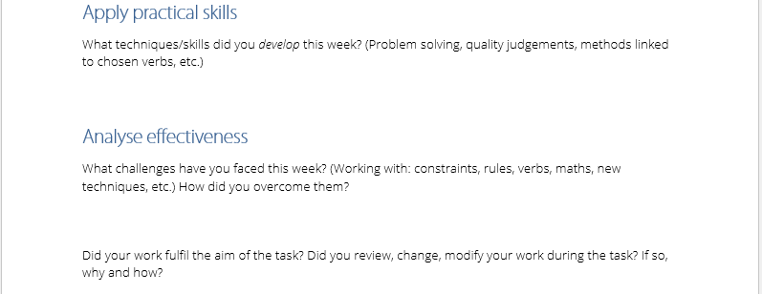
The Art of using Target Setting

Slide 25
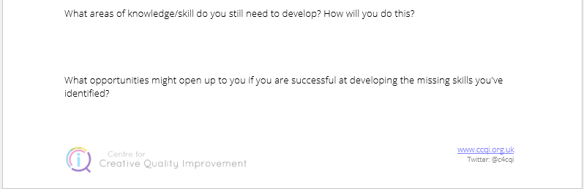
The Art of using Target Setting

Slide 26
The Art of using Target Setting
What might you take away from this session?

Slide 27
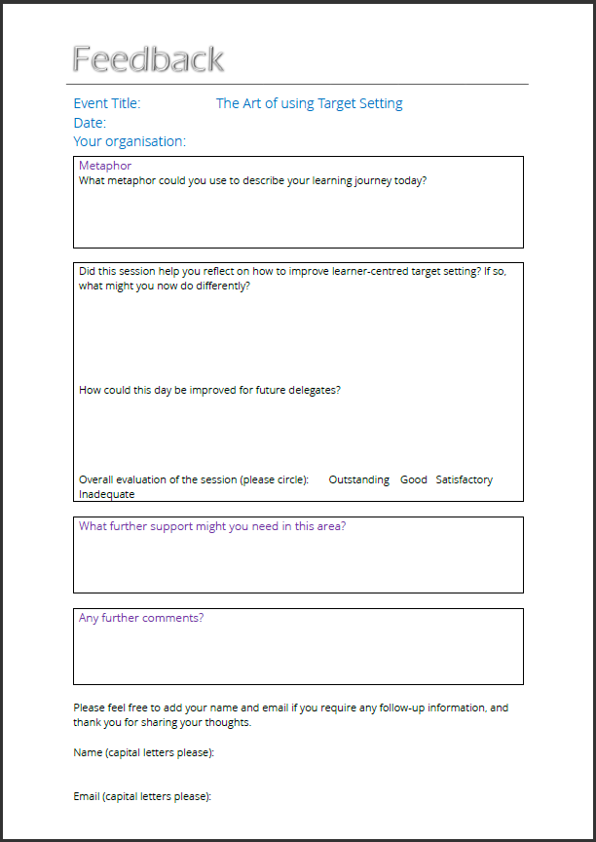
The Art of using Target Setting
Tony Davis
@c4cqi
www.ccqi.org.uk

