Slide 1

Assessment and the Art of Lazy Teaching
Tony Davis
LinkedIn: @tonydavis

Slide 2
Assessment and the Art of Lazy Teaching
Ofsted on Assessment

Slide 3
Assessment and the Art of Lazy Teaching
Ofsted on Assessment
Teachers’ testing and checking of learners’ knowledge is under-developed.
Teachers do not provide learners with sufficiently detailed oral feedback.
Apprentices make slow progress.
Teachers fail to plan adequately for learners to deepen and extend their learning, and do not always establish what a learner can or cannot do before progressing to the next activity.

Slide 4
Assessment and the Art of Lazy Teaching
TLA

Slide 5
Assessment and the Art of Lazy Teaching
TLA
Teaching
Assessment
Learning

Slide 6
Assessment and the Art of Lazy Teaching
TLA
Teaching
Assessment
Learning
TAL

Slide 7

Assessment and the Art of Lazy Teaching
Silent Minute
Define ‘Assessment’

Slide 8
Assessment and the Art of Lazy Teaching
Define ‘Assessment’
The action or an instance of making a judgment about something.

Slide 9
Assessment and the Art of Lazy Teaching
Define ‘Assessment’
The action or an instance of making a judgment about something.
Summative Assessment/Exam

Slide 10
Assessment and the Art of Lazy Teaching
Define ‘Assessment’
The action or an instance of making a judgment about something.
Summative Assessment/Exam
TAL becomes TEL

Slide 11
Assessment and the Art of Lazy Teaching
T FA L

Slide 12
Assessment and the Art of Lazy Teaching
T FA L
Define Formative Assessment

Slide 13
Assessment and the Art of Lazy Teaching
T FA L
Define InFormative Assessment

Slide 14
Assessment and the Art of Lazy Teaching
T FA L
Define InFormative Assessment
Strategies that show how a learner has changed and what they need to do next.

Slide 15
Assessment and the Art of Lazy Teaching
T FA L
Define InFormative Assessment
Strategies that show how a learner has changed and what they need to do next.

Slide 16
Assessment and the Art of Lazy Teaching
T FA L
Define InFormative Assessment
Intrinsic vs. Extrinsic

Slide 17
Assessment and the Art of Lazy Teaching
Ofsted on Assessment

Slide 18
Assessment and the Art of Lazy Teaching
Ofsted on Assessment
Teachers’ testing and checking of learners’ knowledge is under-developed.
Teachers do not provide learners with sufficiently detailed oral feedback.
Teachers do not always establish what a learner can or cannot do before progressing to the next activity.

Slide 19
Assessment and the Art of Lazy Teaching
‘The indispensable conditions for improvement are that the student comes to hold a concept of quality roughly similar to that held by the teacher, is able to monitor continuously the quality of what is being produced during the act of production itself, and has a repertoire of alternative moves or strategies from which to draw at any given point. In other words, students have to be able to judge the quality of what they are producing and be able to regulate what they are doing during the doing of it’.
Royce Sadler 1989

Slide 20
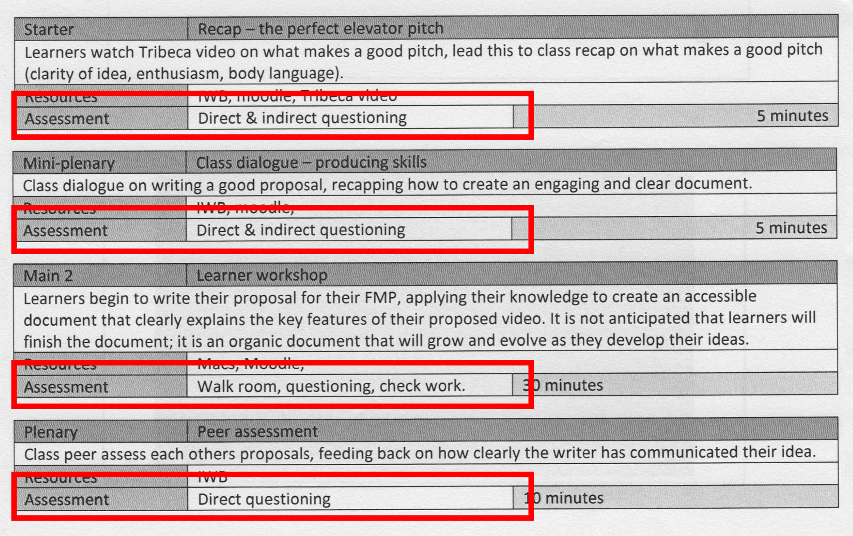
Assessment and the Art of Lazy Teaching

Slide 21

Assessment and the Art of Lazy Teaching

Slide 22
Assessment and the Art of Lazy Teaching
They’re not about
general questioning techniques, or
teachers giving feedback, or
yet more marking of learners’ work.

Slide 23
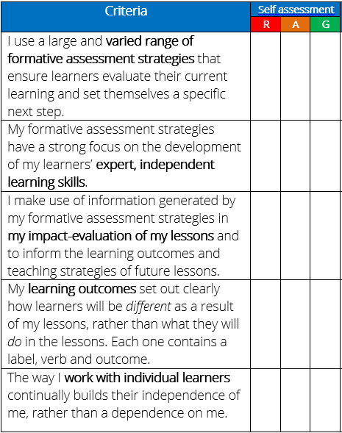
Assessment and the Art of Lazy Teaching

Slide 24
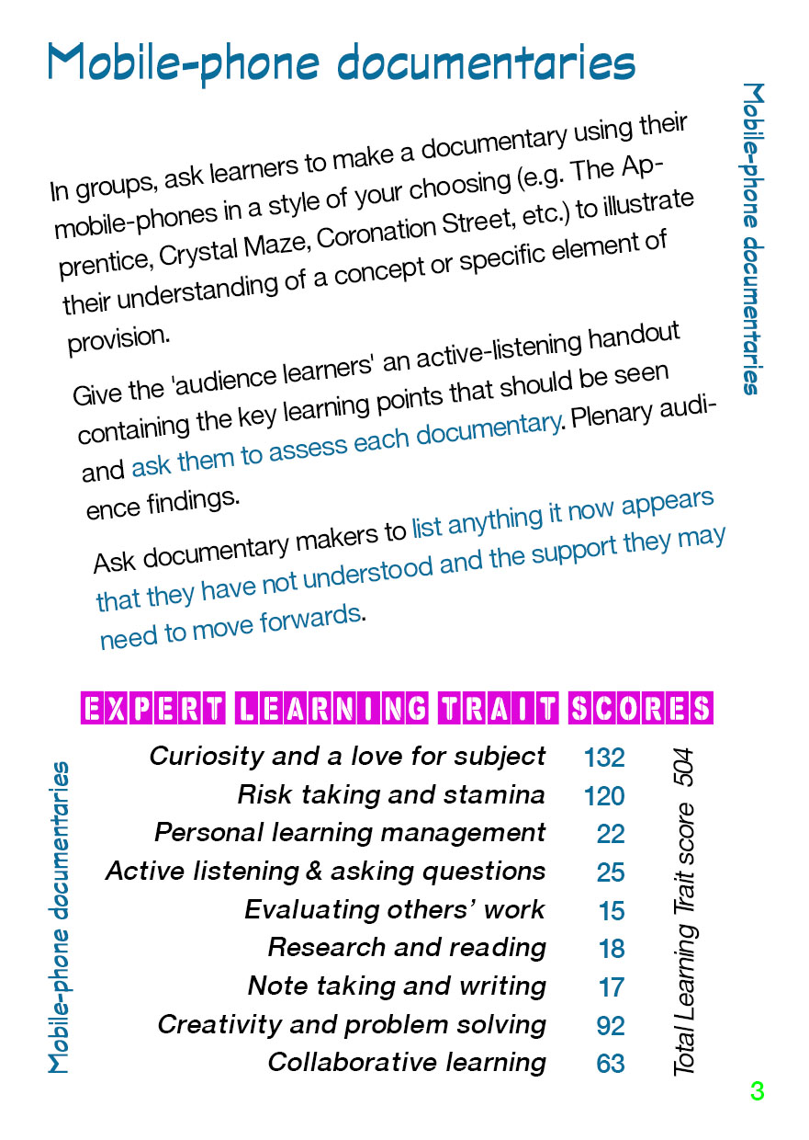
Assessment and the Art of Lazy Teaching

Slide 25

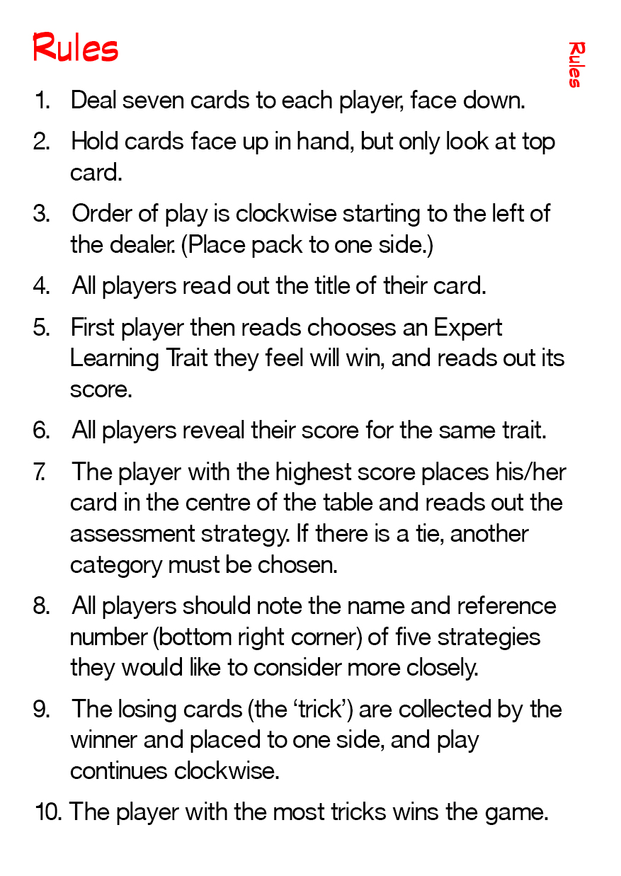
Assessment and the Art of Lazy Teaching

Slide 26
Assessment and the Art of Lazy Teaching
__

Slide 27
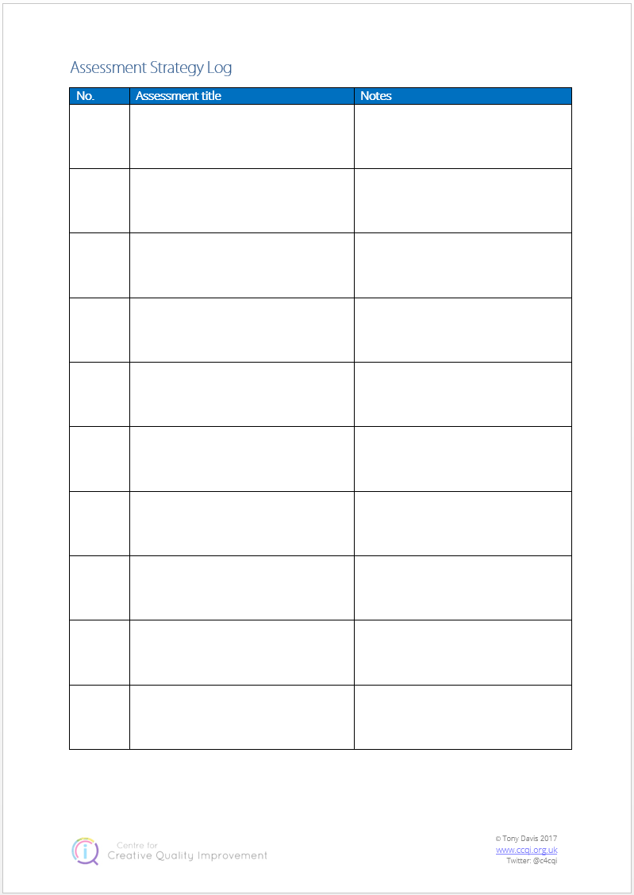
Assessment and the Art of Lazy Teaching

Slide 28
Assessment and the Art of Lazy Teaching
Winner
does not
stay on

Slide 29
Assessment and the Art of Lazy Teaching
Please don’t write on the cards or bend them – thank you!

Slide 30

Assessment and the Art of Lazy Teaching
Don’t forget to fill in your Assessment Strategy Log!

Slide 31
Assessment and the Art of Lazy Teaching
Silent Minute
Review Assessment Strategy Log
Write a question,
comment or implication

Slide 32
Assessment and the Art of Lazy Teaching
After the break, two players from each group are to move clockwise to the next table.

Slide 33

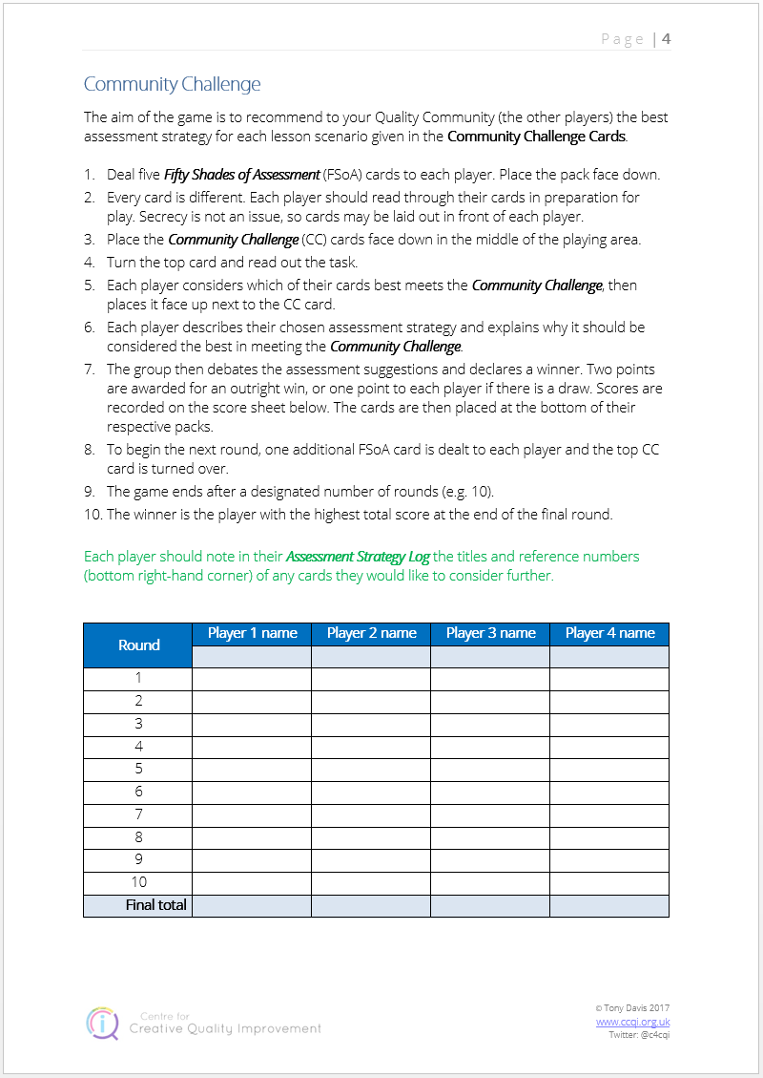
Assessment and the Art of Lazy Teaching

Slide 34
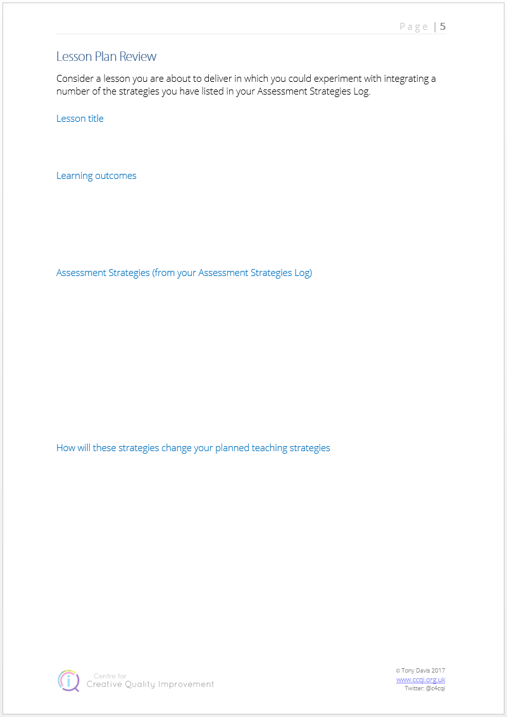
Assessment and the Art of Lazy Teaching
Applying the assessment strategies

Slide 35
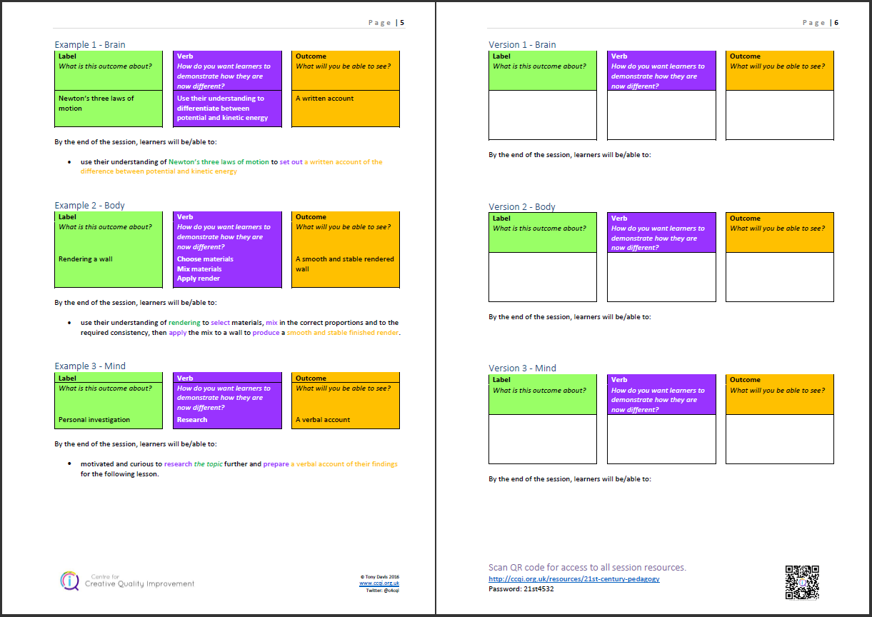
Assessment and the Art of Lazy Teaching
Applying the assessment strategies

Slide 36
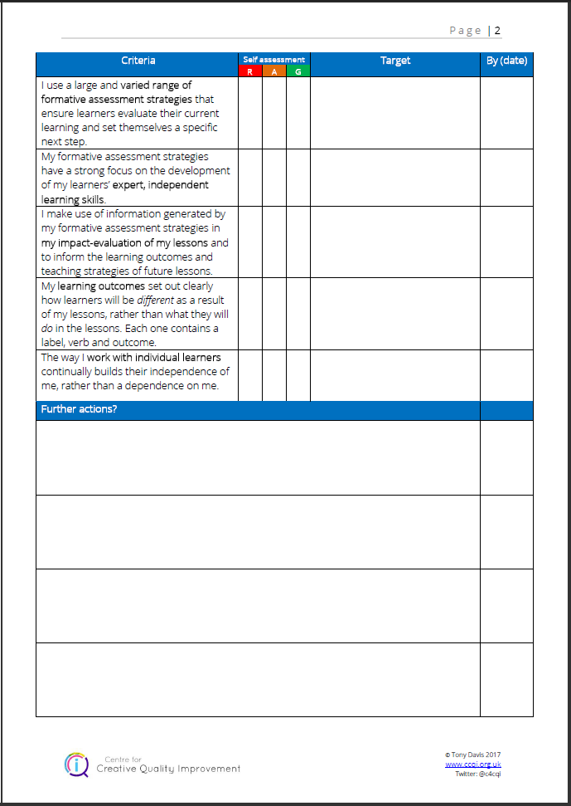
Assessment and the Art of Lazy Teaching
Applying the assessment strategies

Slide 37

Assessment and the Art of Lazy Teaching
http://ccqi.org.uk/assessmentresources
Password: aalt7195

Slide 38
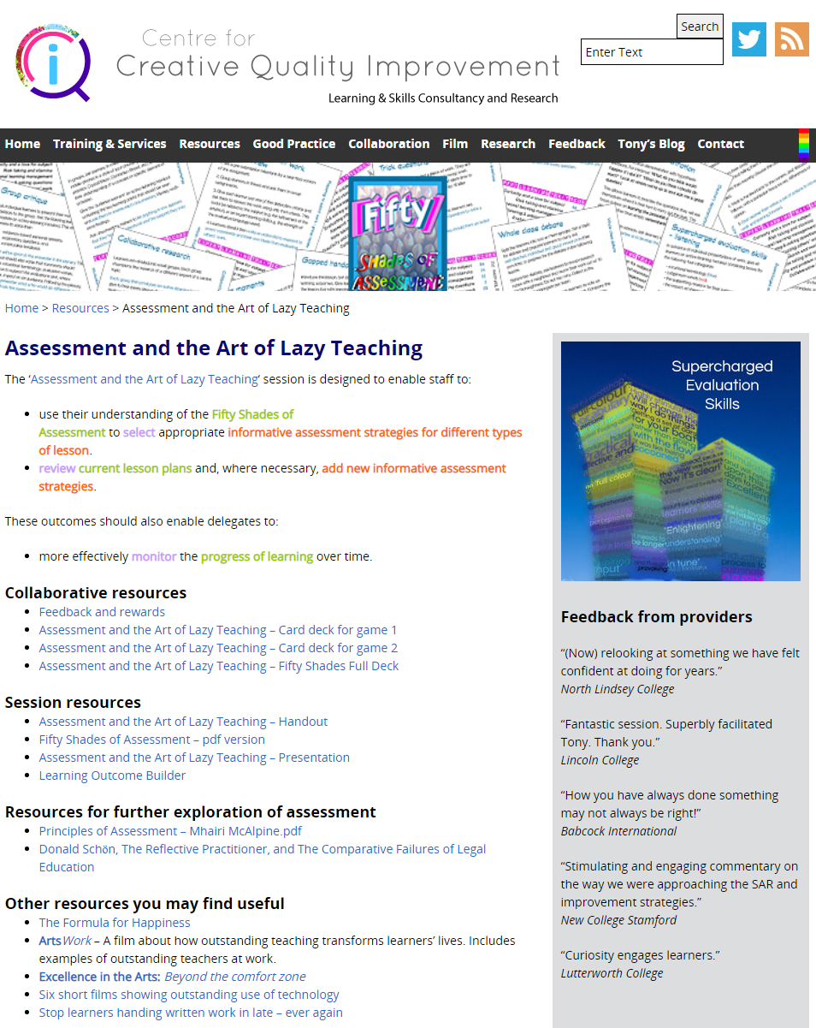
Assessment and the Art of Lazy Teaching
http://ccqi.org.uk/assessmentresources
Password: aalt7195

Slide 39
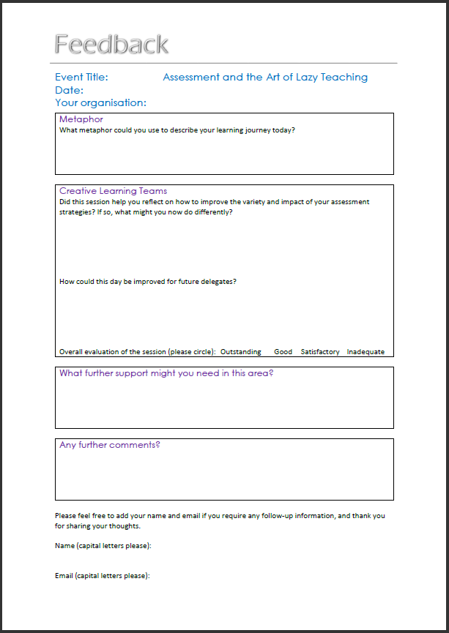
Assessment and the Art of Lazy Teaching
Tony Davis
tony@ccqi.org.uk
@c4cqi

