Slide 1

The Quality Standard
Tony Davis
LinkedIn: @tonydavis
www.ccqi.org.uk

Slide 2
The Quality Standard
How good are you?

Slide 3
The Quality Standard
How good are you?
At what?

Slide 4
The Quality Standard
How good are you?
At what?
How good are you at making sandcastles?

Slide 5
The Quality Standard
How good are you?
At what?
How good are you at making sandcastles?
What are we judging against?

Slide 6


The Quality Standard – for sandcastle building
Grade 4 ………………………………………………1

Slide 7

The Quality Standard – for sandcastle building
Grade 4 ………………………………………………1

Slide 8
The Quality Standard – for sandcastle building
A clear picture of what outstanding looks like is essential to making an accurate judgement.

Slide 9
The Quality Standard
How good are you at teaching?

Slide 10
The Quality Standard
How good are you at teaching?
What are we judging against?

Slide 11
The Quality Standard
How good are you at teaching?
What are we judging against?
In order to be able to judge something, what must you evaluate?

Slide 12
The Quality Standard
How good are you at teaching?
What are we judging against?
In order to be able to judge something, what must you evaluate?
The difference we make.

Slide 13
The Quality Standard
What would you like to hear them say about their Induction experience?

Slide 14
The Quality Standard
By the end of the session, delegates will be able to:
write a set of statements that set out how they want their learners to be different as a result of their teaching and assessment work. [To produce a Quality Standard for TLA]

Slide 15
The Quality Standard
Look at the format of a Quality Standard
Produce a framework for your standard (the content headings)
Set out the difference you want to make

Slide 16
The Quality Standard
Phase 1 The need for change
Phase 2 The Quality Standard
Phase 3 New ideas
Phase 4 Trying out your new ideas
Phase 5 Mid-game review
Phase 6 Evaluating & refining your Quality Standard

Slide 17
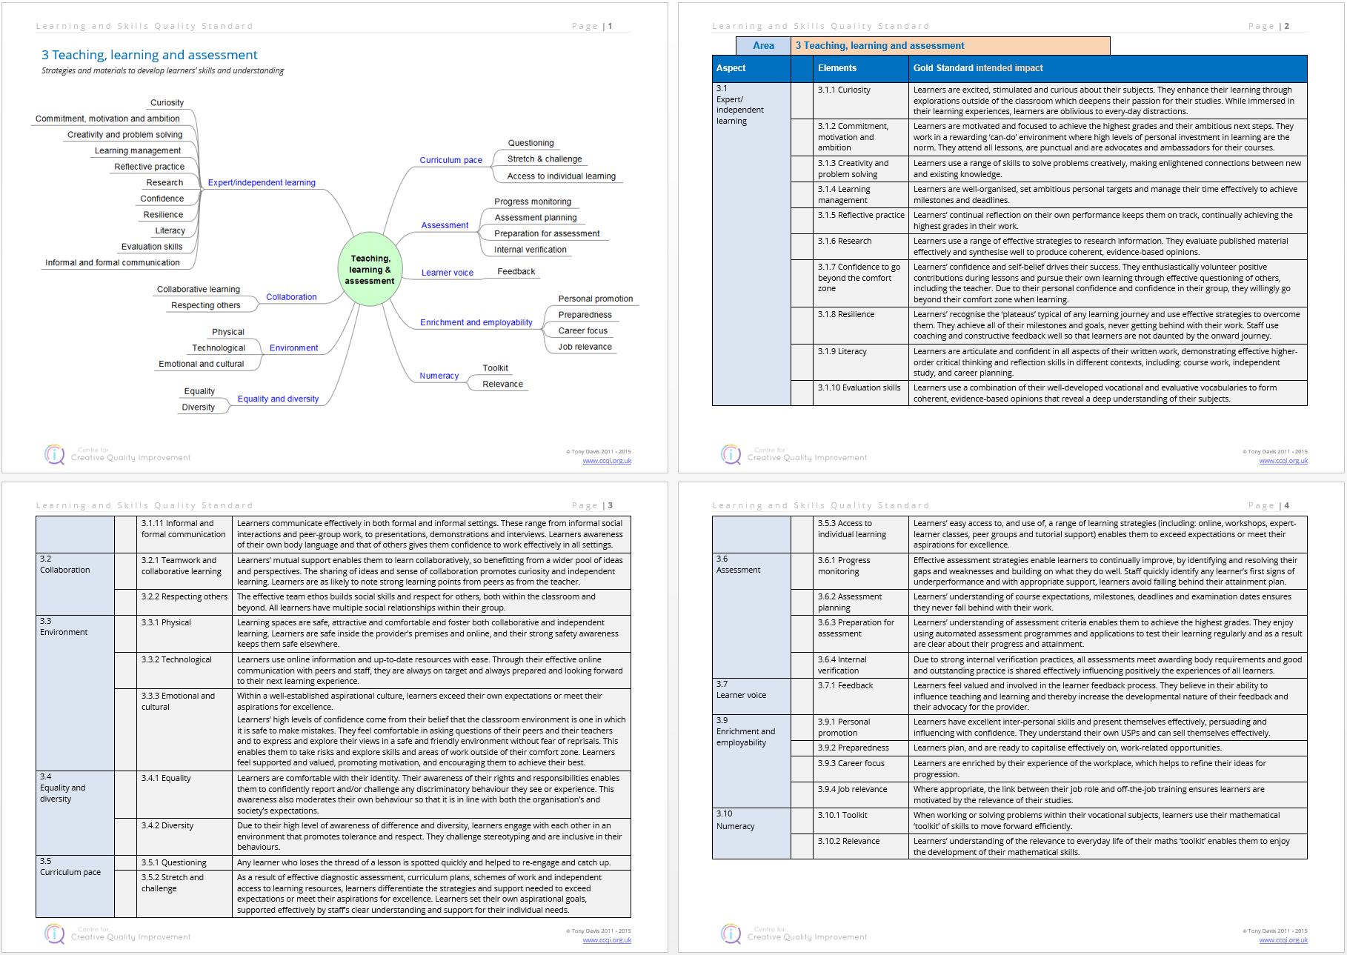
The Quality Standard

Slide 18
The Quality Standard
Recruitment
Induction
Teaching, learning and assessment
Progress monitoring
Support
Achievement
Progression

Slide 19
The Quality Standard
Curriculum management
Central leadership and management
Governance

Slide 20
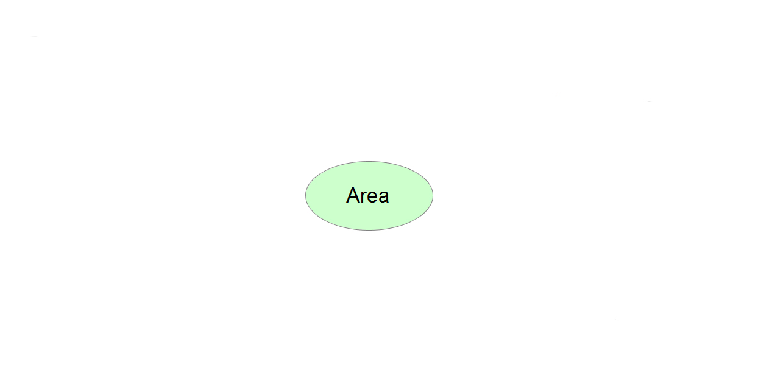
The Quality Standard

Slide 21
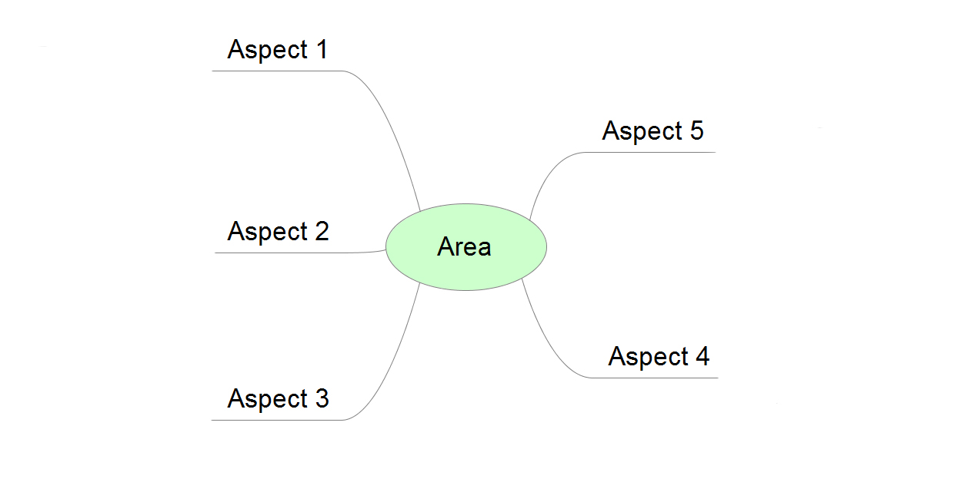
The Quality Standard

Slide 22
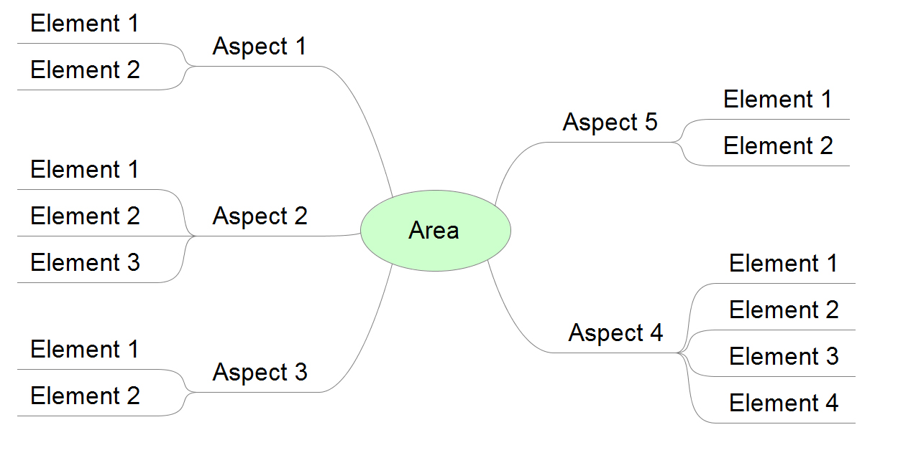
The Quality Standard

Slide 23
The Quality Standard
What are the main ‘aspects’ of TLA?
NB. This isn’t a process for setting out what you currently do, it’s for setting out your aspiration.

Slide 24
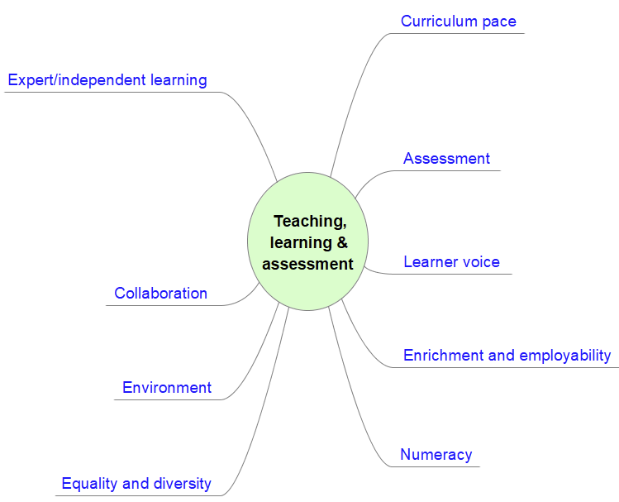
The Quality Standard

Slide 25
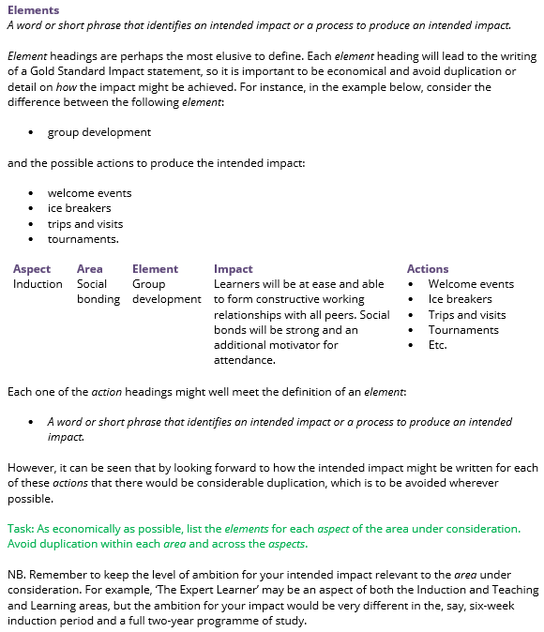
The Quality Standard
For each Aspect heading, write the Elements: the sub-headings under which you’ll write your impact text.

Slide 26
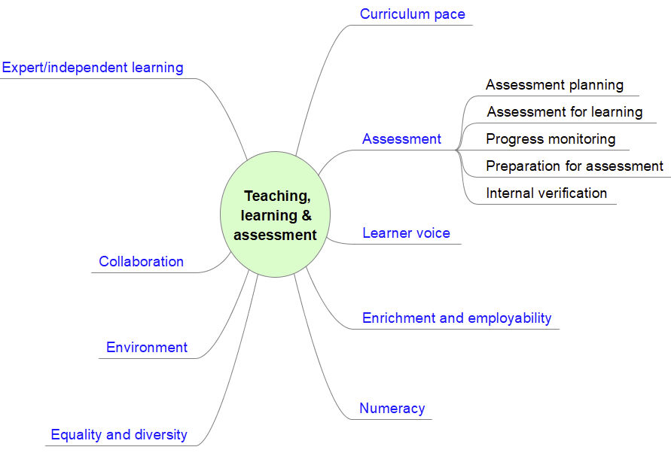
The Quality Standard
x

Slide 27
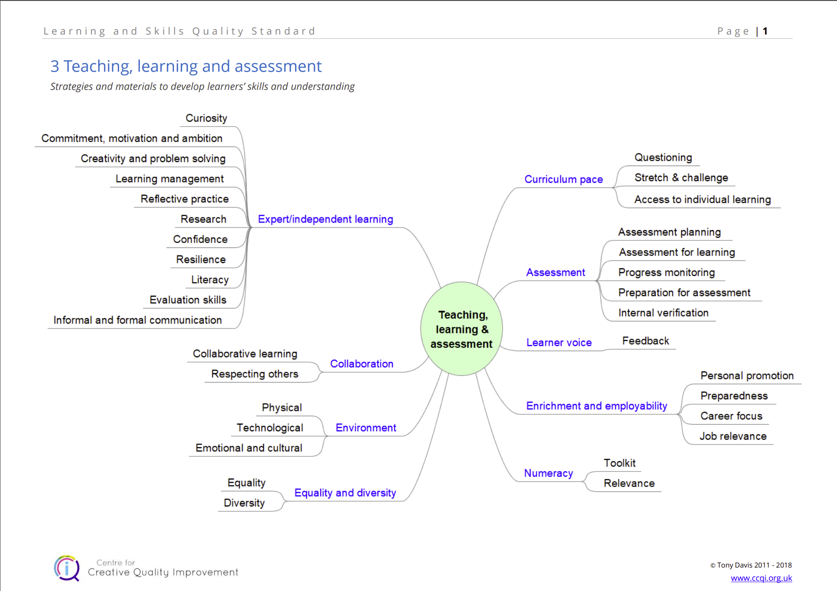
The Quality Standard

Slide 28
The Quality Standard – Gold Standard Impact text
When we're writing impact text, the tense and style of writing must be active – as if you have a time machine and have whizzed forward: what is it that you can see learners doing?
In other words, avoid:
• learners have access to
• learners are enabled to
• learners have the opportunity to
We need to write:
• learners [verb]

Slide 29
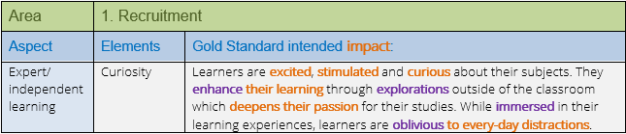
The Quality Standard – Gold Standard Impact text

Slide 30
The Quality Standard – Gold Standard Impact text
Progress monitoring
Aspect: Goal setting
  Element: Career aspiration management
Learners make informed choices about their next steps and are inspired to work towards a clear goal or a narrow range of options.
•

Slide 31
The Quality Standard – Gold Standard Impact text
Progress monitoring
Aspect: Attainment monitoring
  Element: Progress with English and maths
Learners use their English and maths skills confidently as tools to address the challenges they face with their studies. All learners meet, at least, the minimum standards required to progress.

Slide 32
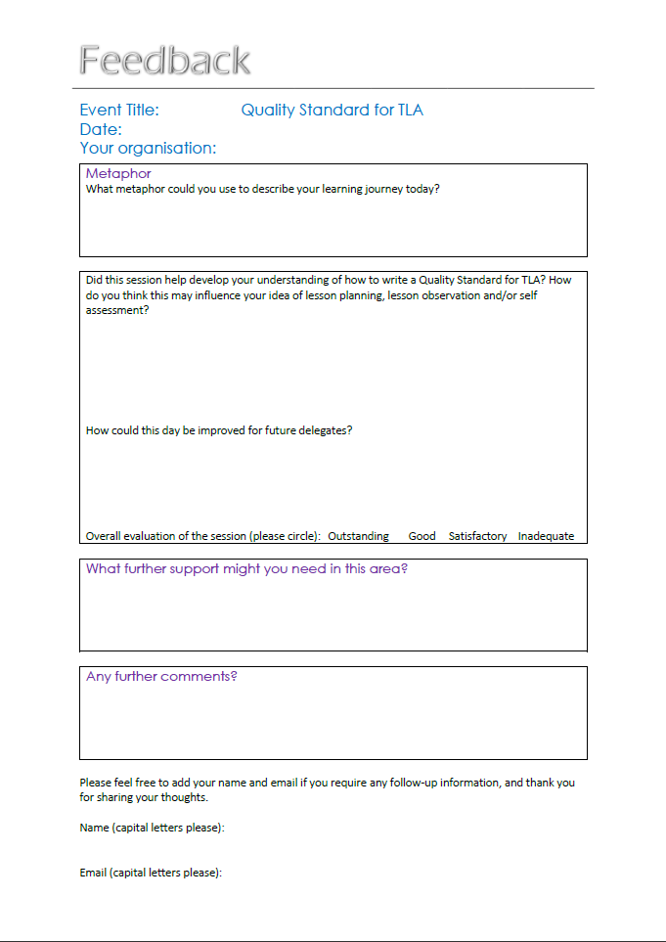
The Quality Standard
LinkedIn: @tonydavis
www.ccqi.org.uk

